Slide 1
Data Stuctures and Algorithms
Dr. Fidaa Abed

Slide 2
Sorting Algorithms
Bubble Sort

Slide 3
Sorting problem
Input: Array of n elements
Output: Array sorted in nondecreasing order

Slide 4
Bubble Sort

Slide 5
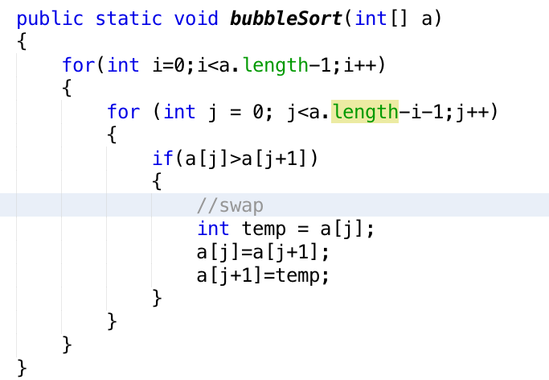
Bubble Sort

Slide 6
Bubble Sort
n+ (n-1) + (n-2) ….. +1 = n(n+1)/2
Worst Case Analysis: O(n^2)
Best Case Analysis: O(n^2)
Average Case Analysis: O(n^2)

Slide 7
Excercise
Write a method that orders an integer array in non-increasing order using Bubble Sort and test this method.
Improve Bubble Sort so that we have best case analysis of O(n)

